Slide 1
Coke vs. Pepsi
Isaiah Sarria, Symrit Sooch, Brandon Connell

Slide 2
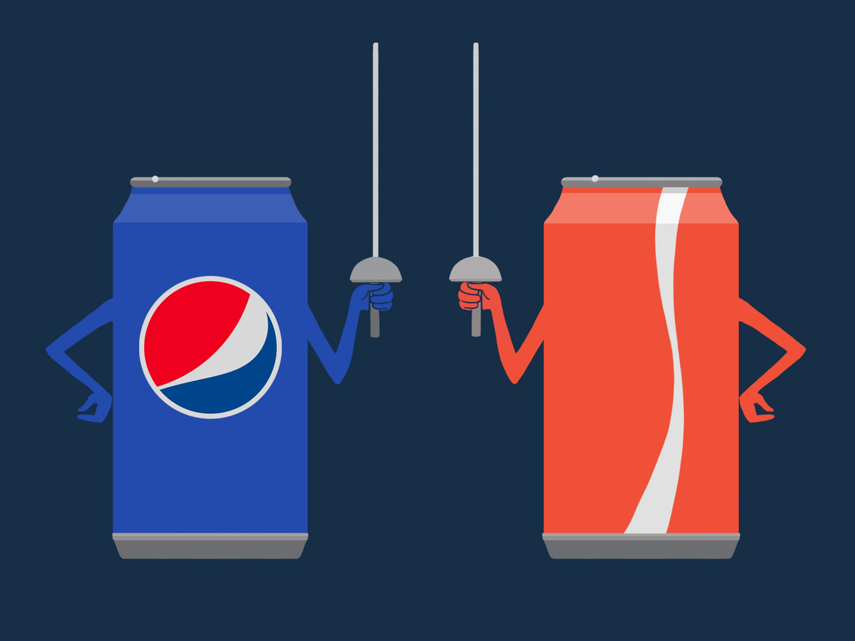
Case Study Overview/Executive Summary
December 2000: PepsiCo and Quaker Oats merger valued at $14 billion.
PepsiCo gains control of Gatorade, dominating over 80% of the sports drink market.
Shift in industry dynamics, PepsiCo is poised to challenge Coca-Cola's market lead.
PepsiCo's restructuring resulted in improved financial performance.
Intense competition in noncarbonated market, with PepsiCo's acquisitions positioning it favorably.
Financial analysis suggest PepsiCo has the potential to out perform Coca-cola.

Slide 3
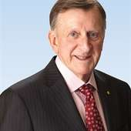
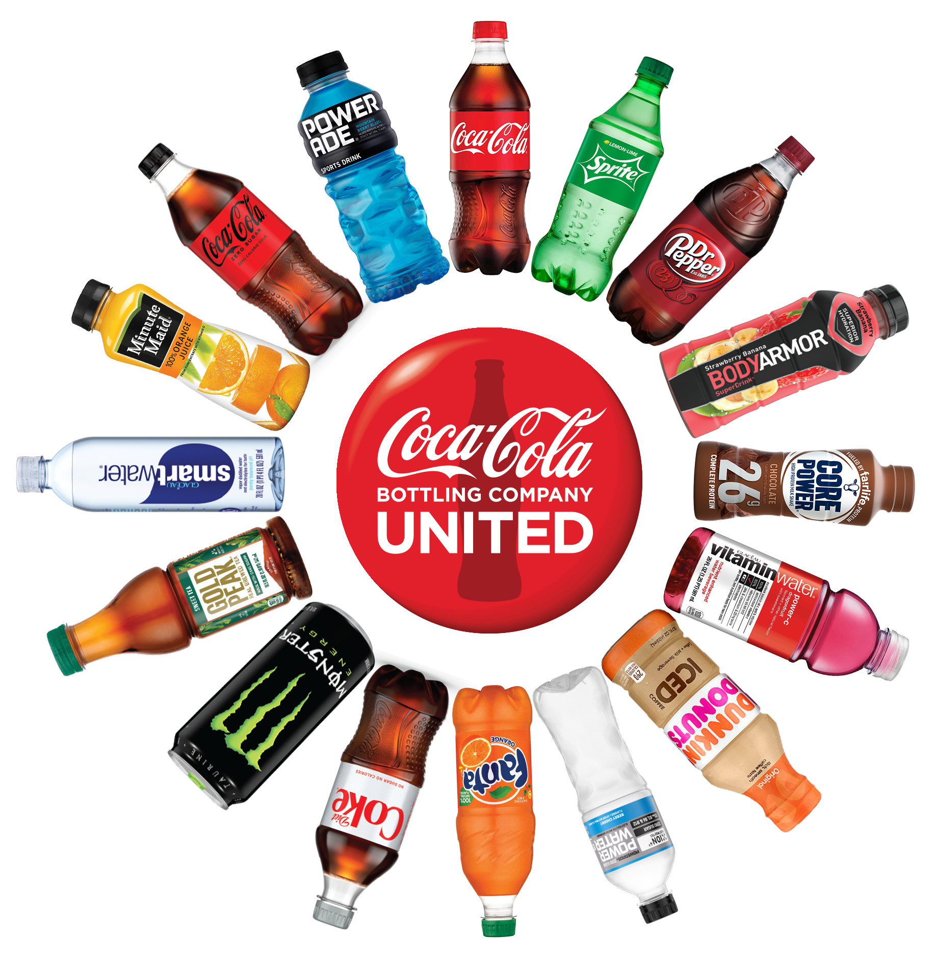
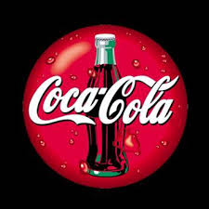
Key Highlights: Coca-Cola
CEOs Tenured:
M. Douglas Ivester: 1997-1999
Douglas Daft: Succeeded Ivester in Dec 2000
Production:
Mainly soft-drinks, but they do have noncarbonated products as well
Current Struggle:
Challenges from previous leadership as well as market conditions, needs to regain share in noncarbonated market
Key Highlights:
New focus on noncarbonated market
Leaderships focus on Organizational restructuring

Slide 4
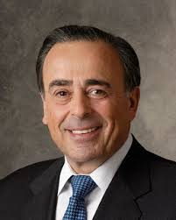
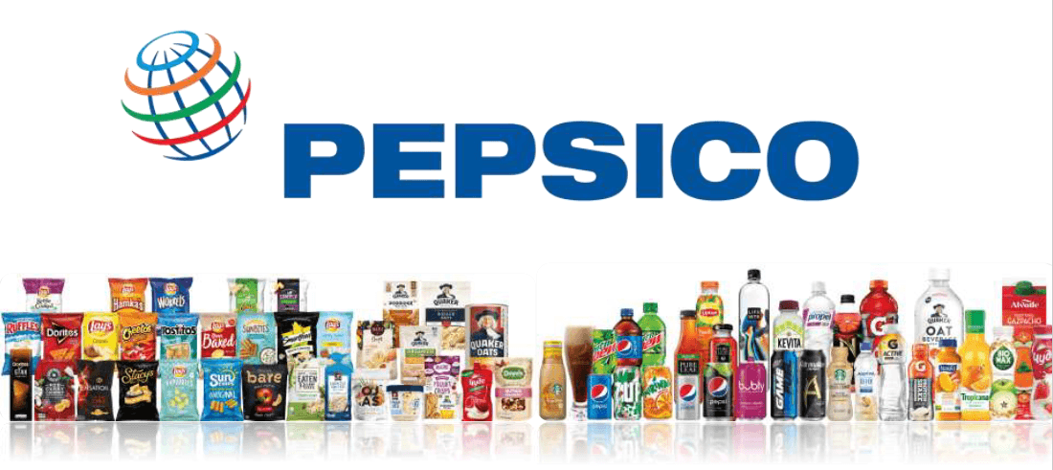
Key Highlights: PepsiCo
CEOs Tenured:
Roger Enrico: 1996-2001
Production:
Diverse manufacturing, soft-drinks to snack foods
Current Struggle:
Competing in the carbonated drink market while maintaining stronghold in the noncarbonated market.
Key Highlights:
Restructuring under Enrico created a more diverse portfolio.

Slide 5
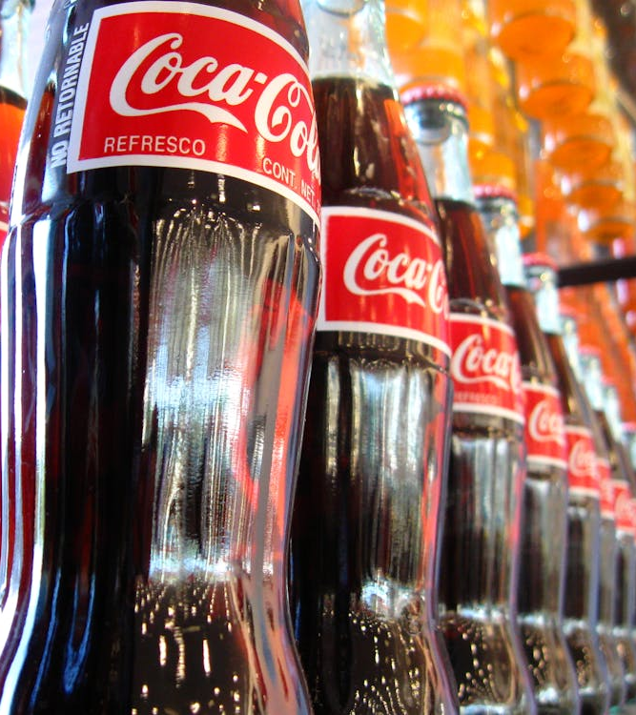
Important Data: Coke
Annual sales of $20.5 billion and market value of $110.1 billion
Market share loss from 1999 to 2000, due to former CEO Ivester's poor management decisions.
Coke's bottlers were upset due to 7.7% price increase on syrup.
Net income fell from 18.2% in 1997 to –31.2% in 1999, under Ivester's leadership.
This steadily increased to –10.4% in 2000.
When it comes to profitability measures, Coke is better than Pepsi.
Coke had higher operating margins, net profit margins, return on assets (ROA), and return on equity (ROE) from 1994 to 1999.
These metrics demonstrate Coca-Cola's strong operational performance and show how profitable they are as a company, when it comes to sales and assets.

Slide 6
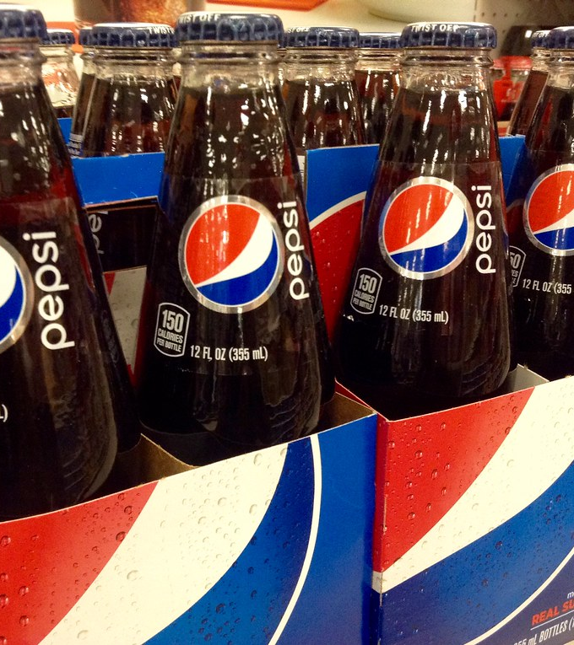
Important Data: Pepsi
In 2000, Pepsi was valued at $20 billion.
Under Enrico’s leadership, Pepsi’s ROE almost doubled from 17% in 1996 to 30% in 2000.
Their EVA figures also significantly improved from 1996 (-$916 million) to 2000 ($1.2 billion).
Have higher liquidity ratios compared to Coke.
Continued to have higher current ratios over the period of 1994 to 2000 than Coke.
Indicates that they are in a better position to pay short-term obligations.
However, Pepsi's growth ratios, particularly their sales, have fluctuated over the years, with the lowest being –33.9% in 1997 .
Coke's lowest sales ratio was only –0.3% in 1998.
Shows that they're less stable than Coke, and raises concerns about their ability to maintain long-term growth momentum.

Slide 7
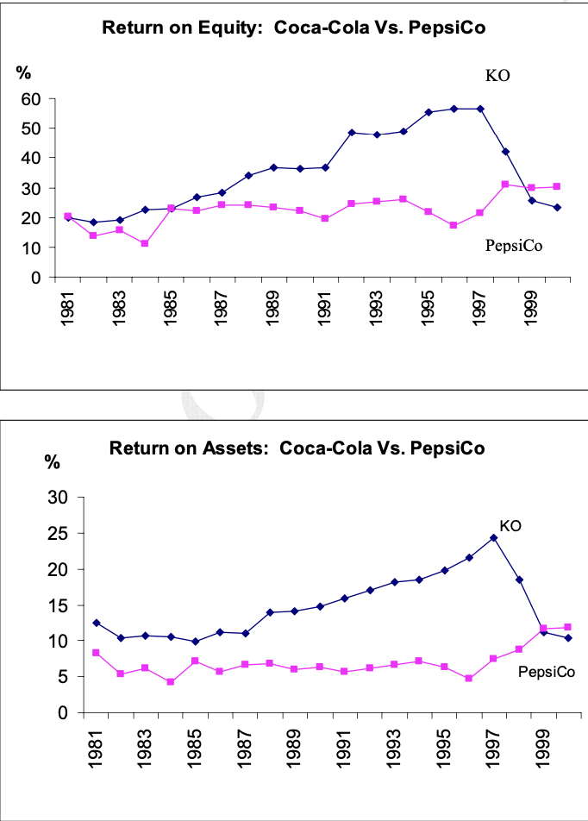
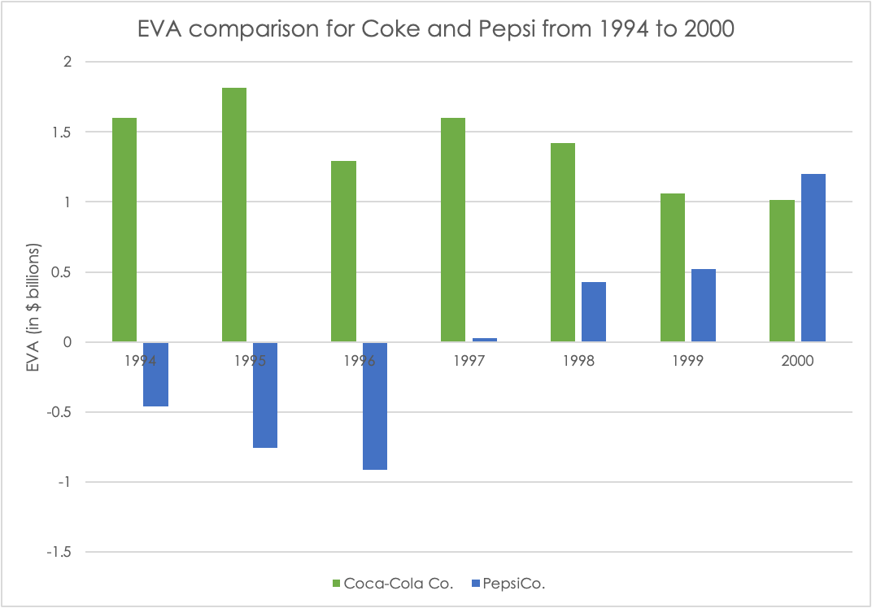
Historical Data

Slide 8
Financial Ratios Comparison: Profitability
 | Coca-Cola Co. |  |  |  | PepsiCo.
Profitability Analysis | 1997 | 1998 | 1999 | 2000 | 1997 | 1998 | 1999 | 2000
Operating Margin | 26.5% | 26.4% | 20.1% | 18.0% | 12.7% | 11.6% | 13.8% | 15.8%
Net profit margin | 21.9% | 18.8% | 12.3% | 10.6% | 10.2% | 8.9% | 10.1% | 10.7%
ROA | 21.1% | 22.9% | 17.3% | 11.5% | 9.6% | 9.3% | 10.2% | 12.2%
ROE | 48.0% | 46.1% | 37.1% | 25.8% | 16.9% | 32.1% | 30.0% | 29.0%
Financial leverage effect | 89.2% | 82.6% | 71.1% | 61.0% | 45.1% | 80.5% | 77.1% | 72.7%
In addition to EVA figures, Coke has consistently exceeded Pepsi in their profitability analysis.
However, there is a slight decrease in 2000. Perhaps due to the transition that Coke's management was going through and an improvement in Pepsi's operations under CEO Roger Enrico.

Slide 9
Future Forecasts: Our EVA analysis
 | Coca-Cola Co. | PepsiCo
Cost of debt | 4.67% | 4.81%
Cost of equity | 8.06% | 7.96%
Weight of Debt (Wd) | 2.8% | 3.9%
Weight of Equity (We) | 97.2% | 96.1%
WACC | 8.0% | 7.8%
Estimated financials for Coke and Pepsi in the future tend to favor Coke.
The forecasted income statements show that Coke has higher net income and operating profit values than Pepsi.
In addition to comparing the future growth of the two companies, the forecasts were also used to perform an EVA analysis for the years 2001 to 2003.
The weighted average cost of capital (WACC) for Pepsi and Coke are shown.

Slide 10
Forecasted EVA analysis for Coca-Cola Co.
Forecasted EVA analysis for Pepsi Co.
 | 2001 | 2002 | 2003
Invested Capital | 16,849 | 17,458 | 17,901
ROIC | 23.5% | 25.6% | 26.8%
WACC | 8.0% | 8.0% | 8.0%
ROIC-WACC Spread | 15.5% | 17.6% | 18.8%
EVA | 2,614 | 3,079 | 3,371
 | 2001 | 2002 | 2003
Invested Capital | 15,877 | 17,567 | 17,550
ROIC | 21.9% | 22.4% | 23.7%
WACC | 7.8% | 7.8% | 7.8%
ROIC-WACC Spread | 14.1% | 14.6% | 15.9%
EVA | 2,234 | 2,558 | 2,785

Slide 11
Who is the more attractive investment?
When comparing the information given in the case study for Coke and Pepsi, we concluded that Coke is the more attractive investment.
The forecasted EVA analysis for 2001 to 2003 shows that Coke is favorable over Pepsi.
They have the ability to invest more capital, essentially generating higher ROIC figures. As a result, Coca-Cola can continue their history of having a foothold in creating economic value.
Coco-Cola also has higher ROIC-WACC spreads than Pepsi, which is the excess return generated by the company compared to the cost of its capital. A higher spread suggests that the company is generating returns above its cost of capital, which indicates high value creation to shareholders.
The forecasts and estimated figures for the future show that The Coca- Cola Company can return to its glory days, especially under new leadership from Douglas Daft.

Slide 12
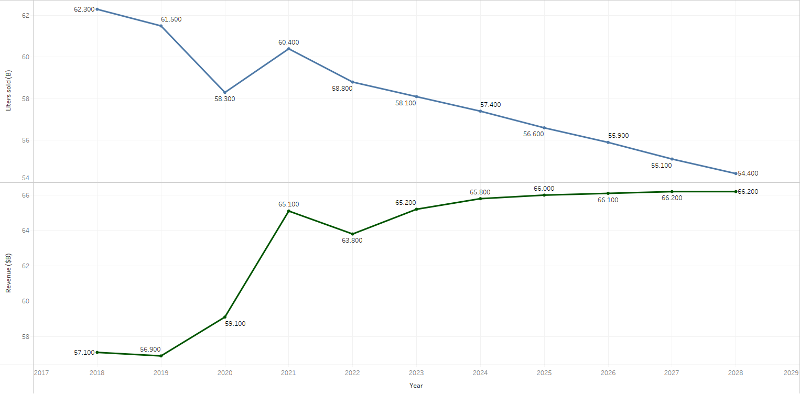
Volume, Revenue, and Projections of Carbonated Drinks NA Market
Notes:
In our forecasts, we apply diverse forecasting techniques. The selection of forecasting techniques is based on the behavior of the relevant market. For example, the exponential trend smoothing is well suited for forecasting the Non-Alcoholic Drinks market with a projected steady growth. The main drivers are GDP per capita and consumer spending per capita

Slide 13
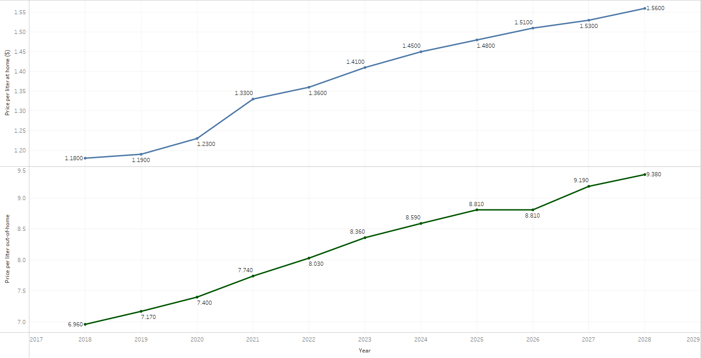
Prices and Projected: At-Home vs Out-of-Home

Slide 14
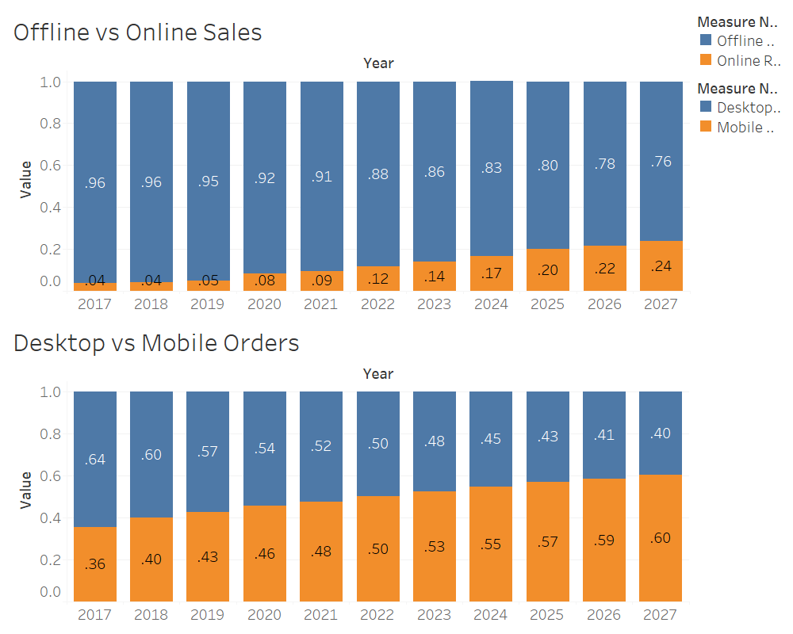

Slide 15
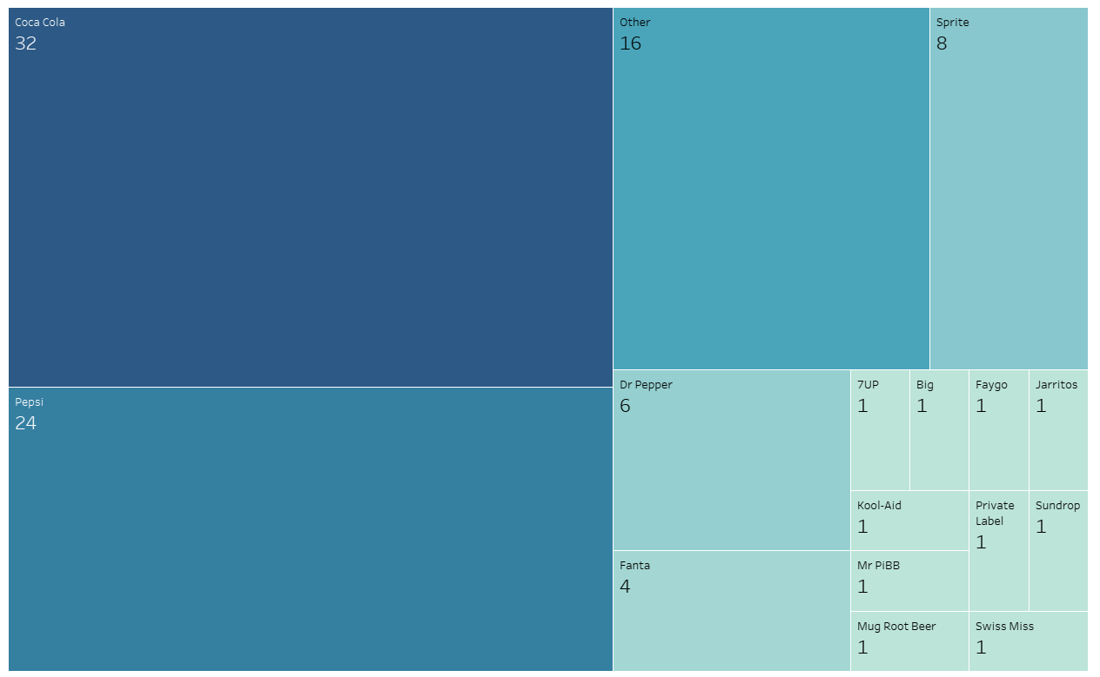
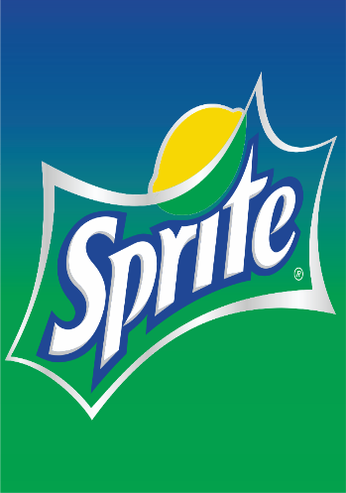
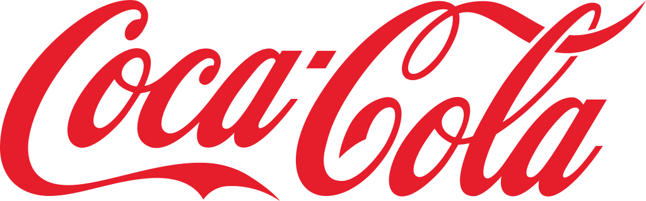
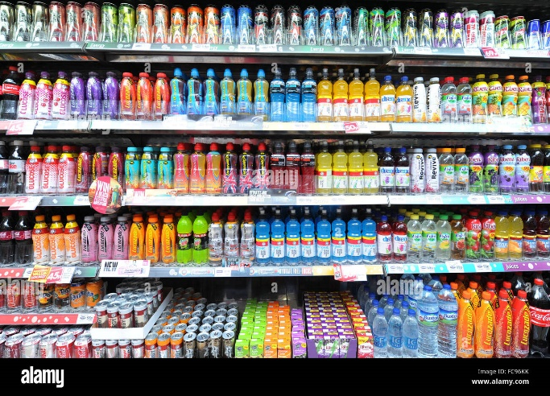
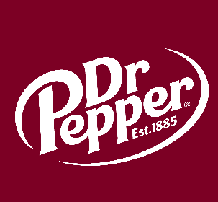
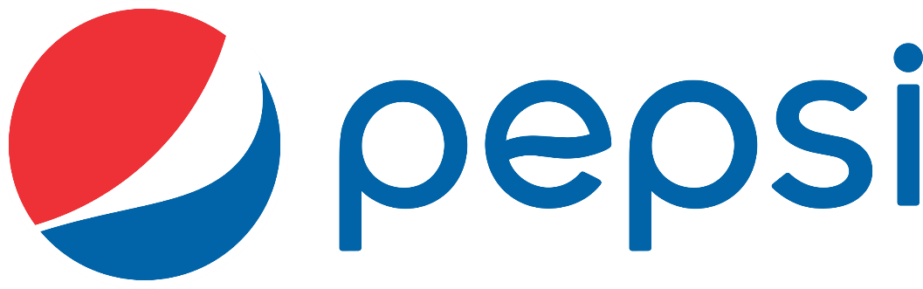
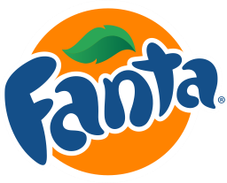
Brand Share, 2022

Slide 16
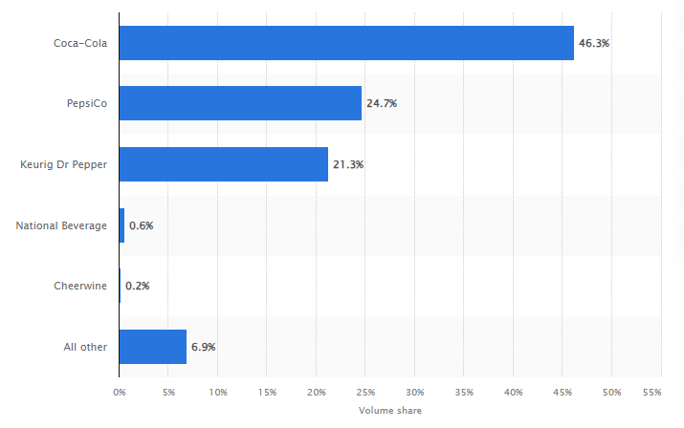
Leading carbonated soft drink (CSD) companies in the United States in 2022, based on volume share
A little different than brand share
Represents the number of shares that are bought and sold everyday
Indicates strength
Higher volume share corelates with high share values

Slide 17
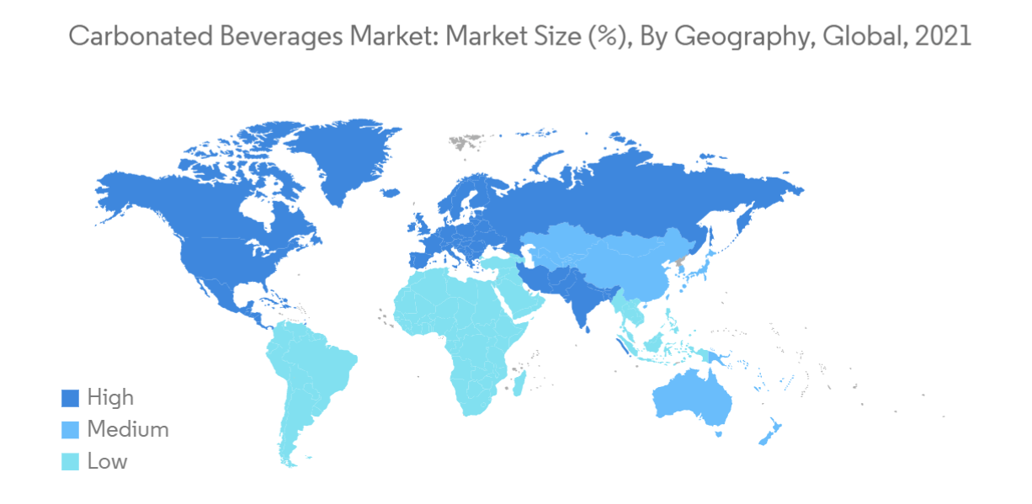
Notes:
North Korea, Norway(Svalbard), and a lot of islands don’t drink carbonated beverages.

Slide 18
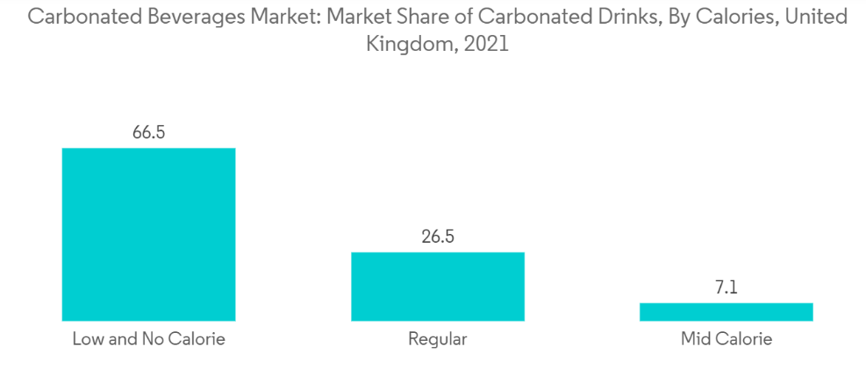
Notes:
Functional drinks like low/zero calorie/sugar, naturally flavored vitamin filled beverages are on the rise for 2024 too

Slide 19


Questions?

Slide 20
Sources
https://www.mordorintelligence.com/industry-reports/carbonated-beverages-market
https://straitsresearch.com/report/soft-drinks-market#:~:text=The%20global%20soft%20drinks%20market,at%20a%20CAGR%20of%205.23%25.
https://www.publicissapient.com/insights/beverage-industry-trends
https://www.austriajuice.com/news-blog/soft-drink-trends
https://www.statista.com/statistics/225504/leading-carbonated-soft-drink-companies-in-the-us/#:~:text=In%202022%2C%20Coca%2DCola%20was,of%2024.7%20percent%20that%20year.
https://www.investopedia.com/articles/technical/02/010702.asp#:~:text=Volume%20measures%20the%20number%20of,gathering%20strength%20to%20the%20downside.
https://www.statista.com/outlook/cmo/non-alcoholic-drinks/soft-drinks/carbonated-soft-drinks/north-america#sales-channels
https://www.statista.com/outlook/cmo/non-alcoholic-drinks/soft-drinks/carbonated-soft-drinks/north-america#revenue
https://www.aon.com/about-aon/corporate-governance/corporate/board-directors/robert-morrison#:~:text=Mr.,President%20and%20Chief%20Executive%20Officer.

